Slide 1



Blockchain Enabled Smart Contracts and Supply Chains

Slide 2


Team members
Mitesh Murthy
1RV22CS115
Lekhana A
1RV22CS098
Manya Chadaga
1RV22CS112
Manoj Kumar B V
RVCE22BCS409

Slide 3
Introduction to Blockchain
Blockchain is a shared, immutable ledger that facilitates the process of recording transactions and tracking assets in a business network. Key elements of a blockchain include decentralisation, distributed ledger technology, immutable records and smart contracts.
Blocks of a blockchain are linked and secured using cryptography, and each block contains a cryptographic hash of the previous block, a timestamp, and transaction data. This creates a tamper-evident record of all transactions on the blockchain.
The data structure of a blockchain is designed to ensure the security, transparency, and immutability of the data it stores.

Slide 4
Our Project
This blockchain-based smart environment for the manufacturing industry integrates blockchain technology to securely push data from sensors into the blockchain network. This setup enhances operational efficiency, ensures data transparency, and boosts security through encryption. By employing a genesis node as the header node and linking subsequent nodes as needed, you establish a robust blockchain network. Utilizing an ESP 32 microcontroller with a DHT11 sensor enables real-time monitoring of temperature and humidity readings, with data directly stored on the blockchain for easy access and tracking. This system empowers organizations to leverage private blockchains for streamlined operations and enhanced data management in manufacturing environments.

Slide 5
Hash Functions In Blockchain
In a blockchain, each block contains a set of transactions and a unique identifier called a hash. This hash is created by running all the data in the block through a cryptographic hash function. The hash serves two main purposes:
1. Data Integrity: Any change to the data in the block would result in a completely different hash. This property ensures that once a block is added to the blockchain, it cannot be altered without changing the hash, making the blockchain tamper-proof.
2. Linking Blocks: Each block's hash includes the hash of the previous block. This linkage creates a chain of blocks, with each block securely connected to the one before it. This feature ensures the chronological order and integrity of transactions in the blockchain.
Overall, hashes play a crucial role in maintaining the security and immutability of the blockchain by ensuring data integrity and establishing the chronological order of transactions.

Slide 6

Methodology
create our second node and link it to the genesis node
other nodes are generated and linked as its required
create a genesis (header) node
store real time data from a DHT11 sensor onto the network
store data directly onto the blockchain network
ESP 32 microcontroller+DHT11 sensor to measure the temperature and humidity readings.

Slide 7
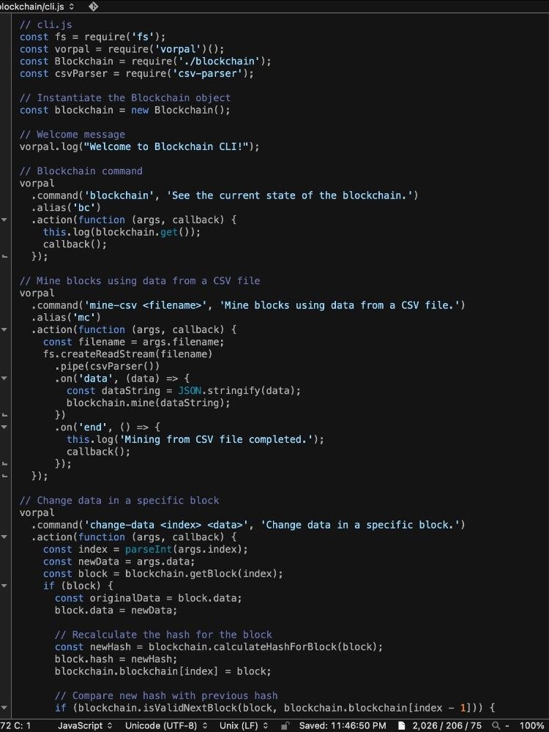
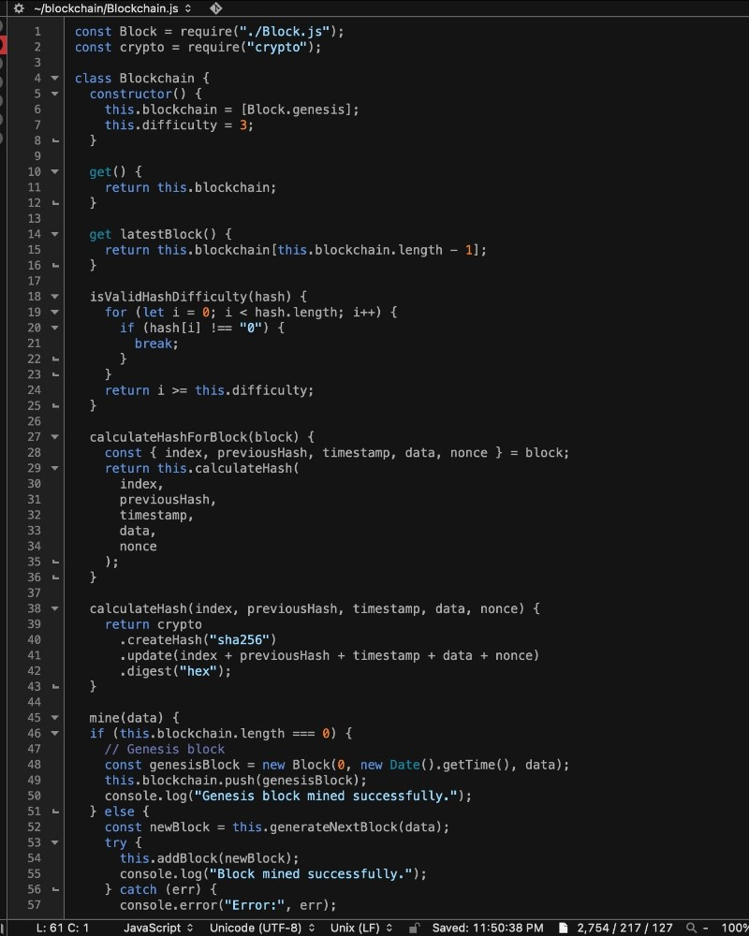
Implementation

Slide 8
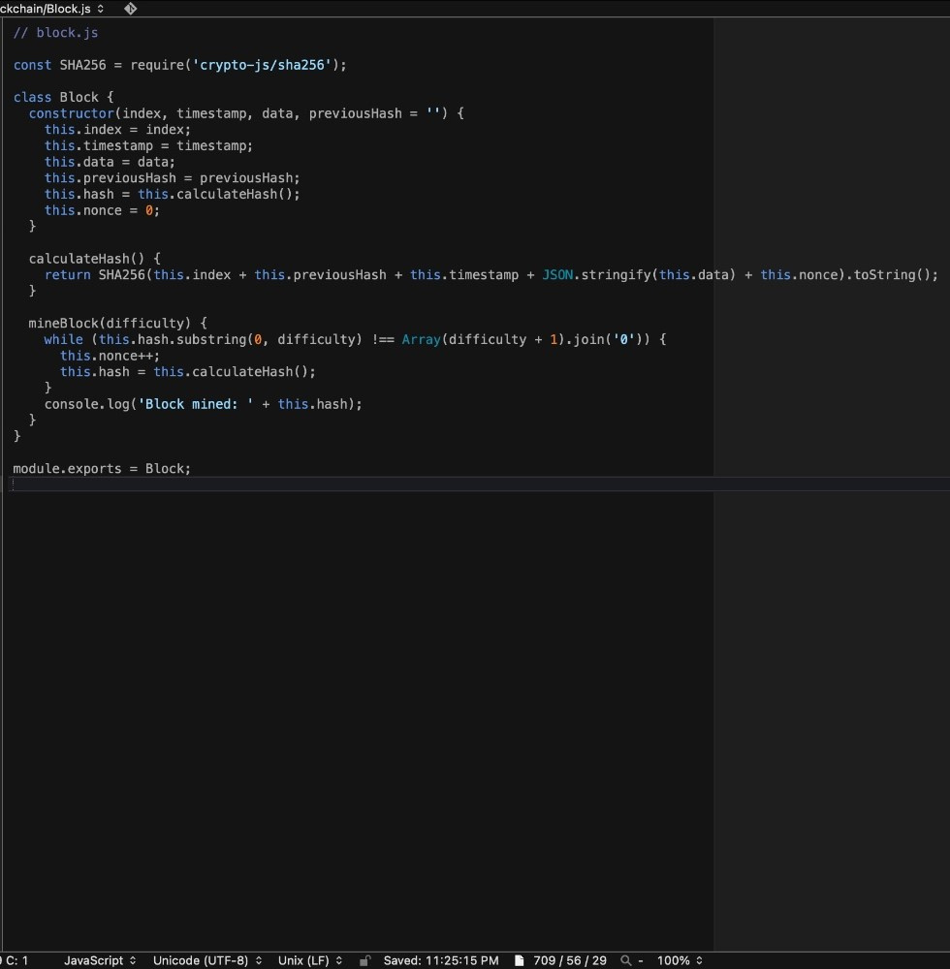

Slide 9
Conclusion
Blockchain is reshaping manufacturing by offering secure and transparent data management. Despite challenges like scalability, ongoing research aims to overcome them, leading to more efficient processes. As blockchain becomes foundational, manufacturing sees transformative shifts towards transparency and collaboration. Despite challenges, blockchain's benefits in enhancing trust and efficiency are significant. Its ability to ensure supply chain traceability improves product quality and safety. Blockchain fosters collaboration among stakeholders, creating a resilient manufacturing ecosystem. With ongoing advancements, blockchain promises indispensable roles in modern manufacturing, enhancing efficiency and competitiveness.

Slide 10
References
Zhi Li, Ali Vatankhah Barenjia, George Q. Huang, Toward a blockchain cloud manufacturing system as a peer to peer distributed network platform, Robotics and Computer Integrated Manufacturing 54 (2018) 133-144
Abirami Raja Santhi and Padmakumar Muthuswamy, Influence of Blockchain Technology in Manufacturing Supply Chain and Logistics, Logistics 2022, 6, 15. https://doi.org/10.3390/ logistics6010015
Chao Zhang, Guanghui Zhou , Member, IEEE, Han Li, and Yan Cao, Manufacturing Blockchain of Things for the Configuration of a Data- and Knowledge-Driven Digital Twin Manufacturing Cell, IEEE INTERNET OF THINGS JOURNAL, VOL. 7, NO. 12, DECEMBER 2020
Nader Mohamed and Jameela Al-Jaroodi, Applying Blockchain in Industry 4.0 Applications, 978-1-7281-0554-3/19/$31.00©2019 IEEE
ABEYRATNE, S.A. and MONFARED, R.P., 2016. Blockchain ready manufacturing supply chain using distributed ledger. International Journal of Research in Engineering and Technology, 05(09), pp. 1-10.
Taehyun Ko, Jaeram Lee and Doojin Ryu, Blockchain Technology and Manufacturing Industry: Real-Time Transparency and Cost Savings, Sustainability 2018, 10, 4274; doi:10.3390/su10114274
Jacob Lohmer, Rainer Lasch, Blockchain in operations management and manufacturing: Potential and barriers Computers & Industrial Engineering 149 (2020) 106789
Zhiting Song and Jianhua Zhu, Blockchain for smart manufacturing systems: a survey, Chinese Management Studies Vol. 16 No. 5, 2022

